Slide 1

SDET Course
Design Patterns - Adapter

Slide 2
3 Types of Design Patterns
Creational
Singleton
Builder
Prototype
Factory Method
Abstract Factory
Structural
Adapter
Composite
Proxy
Flyweight
Bridge
Facade
Decorator
Behavioral
Strategy
Observer
Command
Memento
State
Template Method
Mediator
Chain of Responsibility
Interpreter
Visitor
Iterator

Slide 3
Agenda
Description
Diagram
Code sample (Java)
Use cases

Slide 4
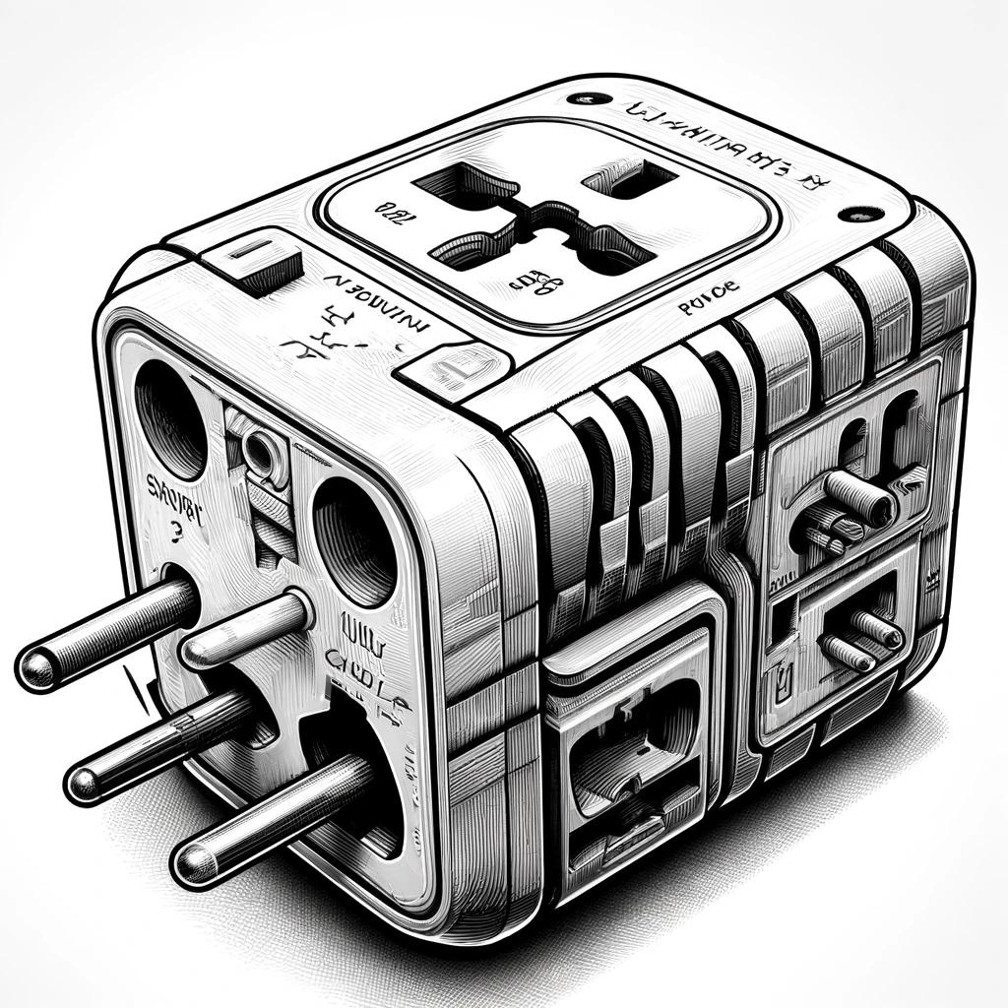
The Problem

Slide 5
Description
The Adapter design pattern is a structural pattern that allows incompatible interfaces to work together. It acts as a bridge between two incompatible interfaces, converting the interface of a class into another interface that a client expects. By doing so, it enables classes with different interfaces to work together seamlessly. The Adapter pattern is particularly useful when integrating legacy code or third-party libraries into modern systems, as it enables them to collaborate without needing to modify their source code.

Slide 6
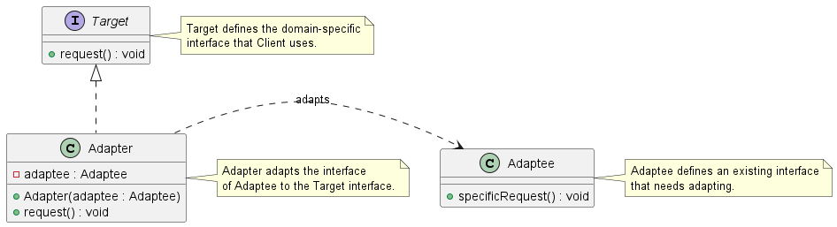
Class Diagram

Slide 7
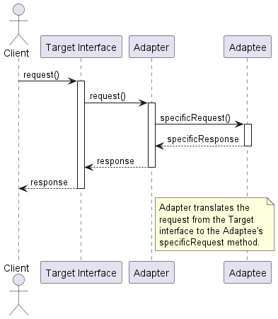
Sequence Diagram

Slide 8
Code Sample

Slide 9
Use cases
General
Legacy Integration
Third Party Libraries
Cross-Platform applications
In Test Automation
Legacy test scripts adaptation
Data format adaptation (JSON, XML etc.)
Appium (vs UIAutomation or XCUITest)

Slide 10
Search Google - Playwright
public class GoogleSearchClickPlaywright {
public static void main(String[] args) {
try (Playwright playwright = Playwright.create()) {
BrowserType.LaunchOptions options = new BrowserType.LaunchOptions();
options.setHeadless(false); // Set to false to see the browser UI
Browser browser = playwright.chromium().launch(options);
BrowserContext context = browser.newContext();
Page page = context.newPage();
page.navigate("https://www.google.com");
// Assuming the Google search box has the name attribute "q"
page.click("input[name='q']");
}
}
}

Slide 11

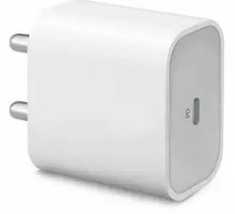

Search Google - Selenium
public class GoogleSearchClickSelenium {
public static void main(String[] args) {
System.setProperty("webdriver.chrome.driver", "path/to/chromedriver");
WebDriver driver = new ChromeDriver();
driver.get("https://www.google.com");
WebElement searchBox = driver.findElement(By.name("q"));
searchBox.click();
}
}

Slide 12
Happy Coding

